Slide 1
Group delay features for openly available dataset-1
Tejaswini Anuhya Suma - 2018102018
Jaideep Kumar-2018102001

Slide 2
Introduction
Speech is a quasi-stationary process and its characteristics are 1D function of time.
Speech has alot of information like language information, speaker information, emotion of the person etc., So its very important to analyse speech properly by extracting as much as information as we can.
Speech can be analysed in many ways as per our requirement of parameters. Some very important and common analyses include Linear Predictive Coding(LPC), Mel Frequency Cepstral Coefficients etc.,
These methods don’t capture the phase information of the signal which can be very useful in many cases, so group delay features can be used

Slide 3
Problem Statement
Pathology in speech refers to communication disorders (speech disorders and language disorders), cognitive-communication disorders, voice disorders, and swallowing disorders.
The most common case of voice channel pathology (especially in children) is due to the cleft palate(Cleft palate, both primarily and secondary, is a hard, unsightly malformation, most commonly encountered in face's fracture).
Cleft palate, direct effect of which is permanent and uncontrolled acoustic feedback between oral and nose channel revealed by forced nasalization of initially non-nose speech sounds.

Slide 4
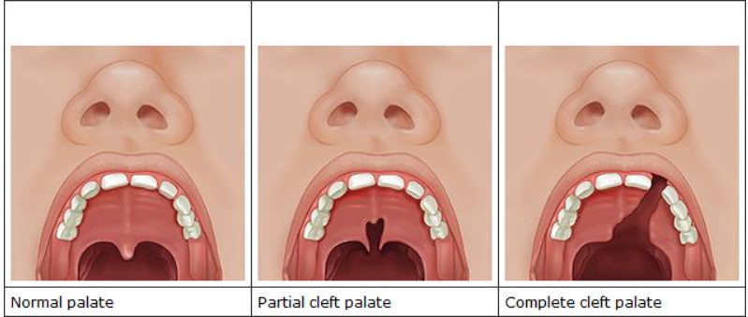
Pictorial Representation
These deformed elements of speech organs are not capable of shaping sound as subtly as healthy organs.
So there would be irregularities in speech related aspects

Slide 5
What is our project?
Our project is to extract group delay features on the pathological dataset and observe/classify how it is different from normal speech using the features.
Our dataset is “Speech Database of Typical Children and Children with Speech Language Impairment”- from children from 4 to 11 years
This dataset is created by the LANNA research group in the Faculty of Electrical Engineering at Czech Technical University in Prague.
Two databases were recorded: one for healthy children’s speech (recorded in kindergarten and in the first level of elementary school) and the other for pathological speech of children with a Specific Language Impairment (recorded at a surgery of speech and language therapists and at the hospital).

Slide 6
Dataset Contents
There 2 main folders in this dataset, Healthy folder and patients folder.
In each folder there are .wav files for different utterances and for different patients.
Vowels, consonants, 1 syllable, 2 syllables...5 syllables.
Number of patients taken for analysis are
Healthy-P26 to P69- 43 persons
Patients-P8 to P61-54 persons
One important thing to note about this dataset is every .wav file resampled to 44.1kHz sampling frequency.
Total number of .wav files are 1680(Healthy)+2079(patients)=3759 speech files.

Slide 7

What is Group Delay?
Group delay is derived from phase information of a signal
To be precise:
Group delay is defined as negative derivative of phase(FT signal).
Let x[n] be a signal, whose continuous phase spectrum is given by θ(e jω) and calculated from fft of cepstrum(ifft(log(fft))) of the signal and use that for group delay functions.

Slide 8
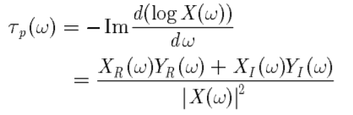
Properties Of Group Delay
Poles and zeros of the transfer function show as peaks and valleys in the group delay function respectively.
The peaks in group delay function plot are having more resolution than compared to magnitude spectrum(high resolution property) because of which this is preferred compared to magnitude spectrum.
Peaks in Group delay spectrum give formant frequencies.
Group delay can be simplified as follows, where Y(ω) is fft of n*x[n](differentiation property of fourier transform)

Slide 9

Product Spectrum/Numerator group delay
Product Spectrum is defined as follows:
The product spectrum is influenced by both the magnitude spectrum and the phase spectrum.
It enhances the region of peaks and poles Group Delay Function and has an envelope comparable to that of the power spectrum.
This Product Spectrum helps in avoiding the spurious peaks which we get in group delay function

Slide 10
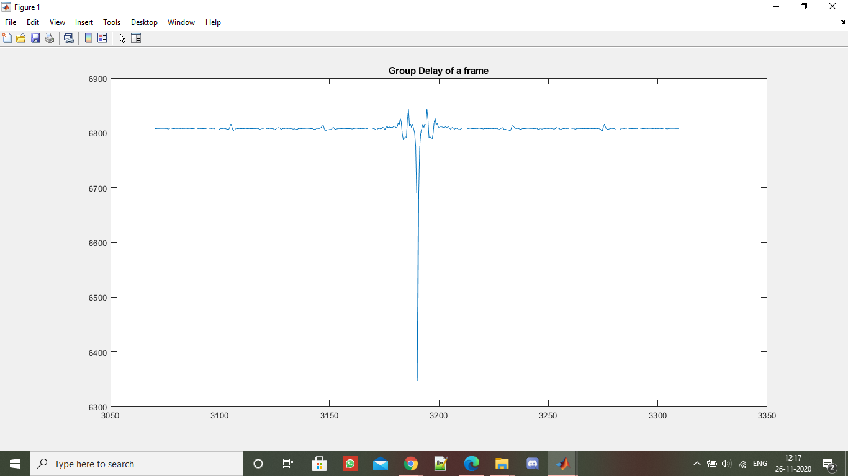
Demo file graphs-(1/2)
Group delay graph of a demo .wav file
Sampling frequency of demo file is 48kHz.

Slide 11
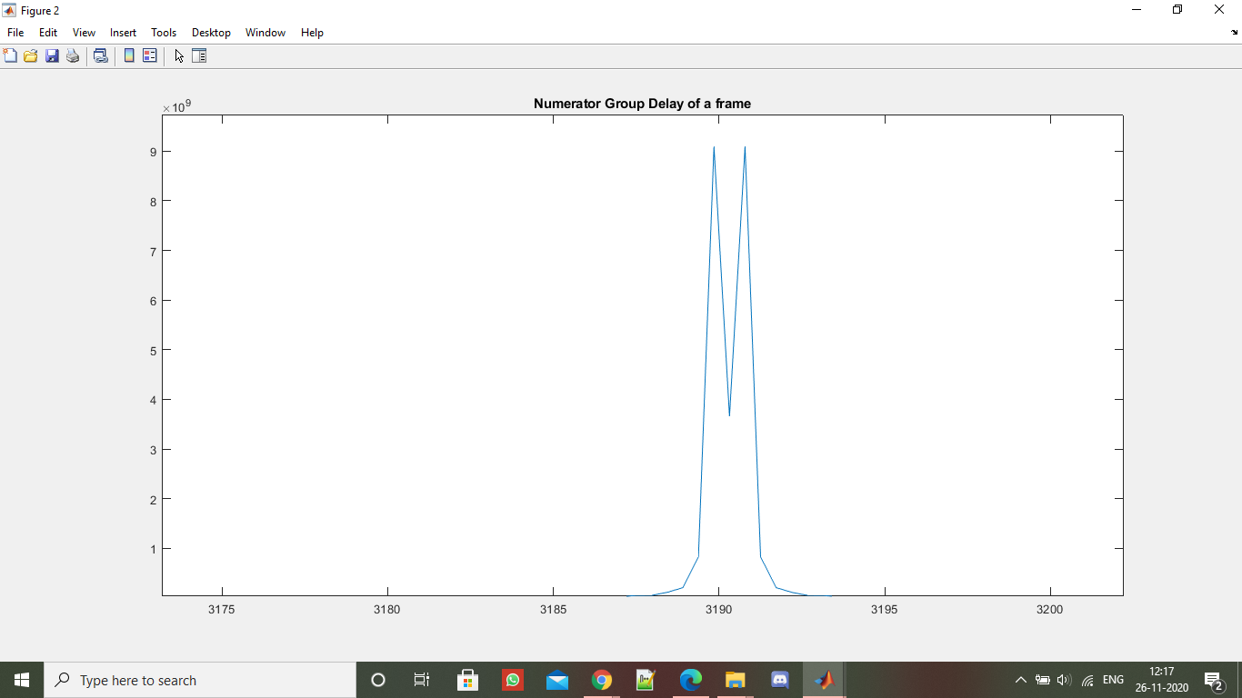
Demo file Graphs-(2/2)
This is numerator group delay function graph for demo file of 48kHz sampling frequency.

Slide 12

Healthy person graphs-(1/2)
This graph is group delay function graph for utterance “a” of a healthy person.
Sampling frequency is 44.1kHz.

Slide 13
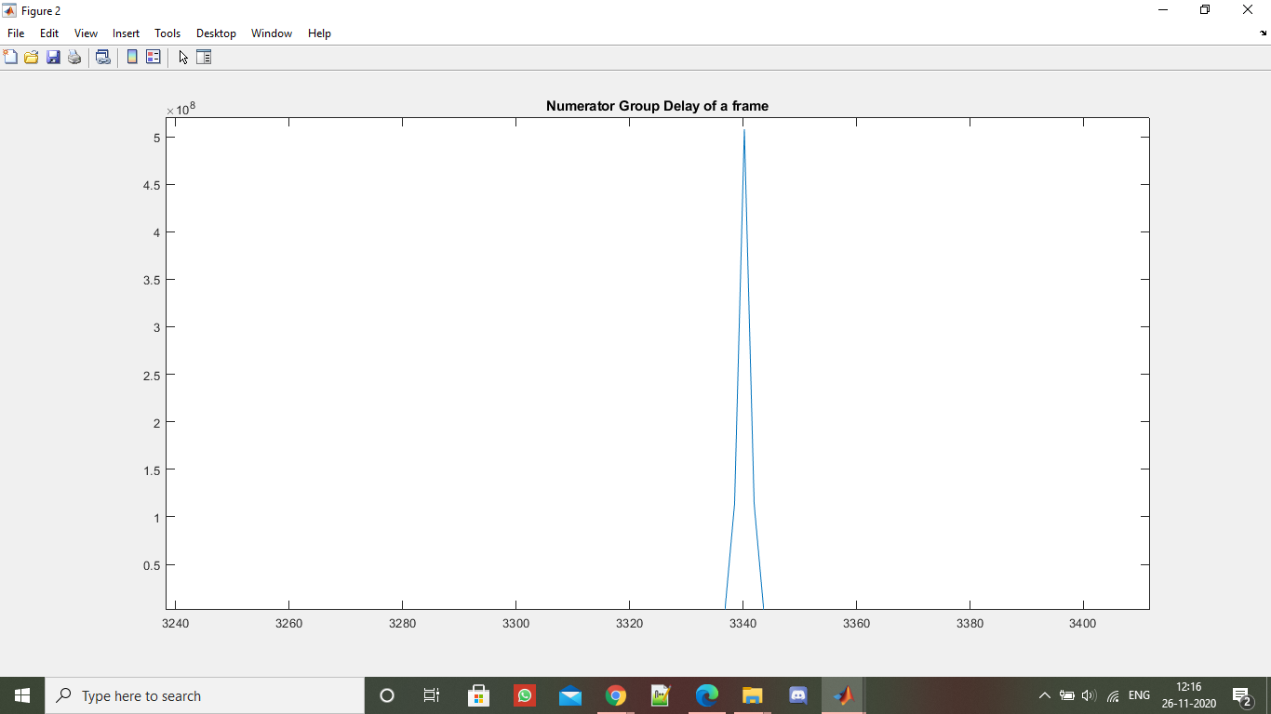
Healthy person graphs-(2/2)
This graph is numerator group delay function graph for utterance “a” of a healthy person.
Sampling frequency is 44.1kHz.

Slide 14
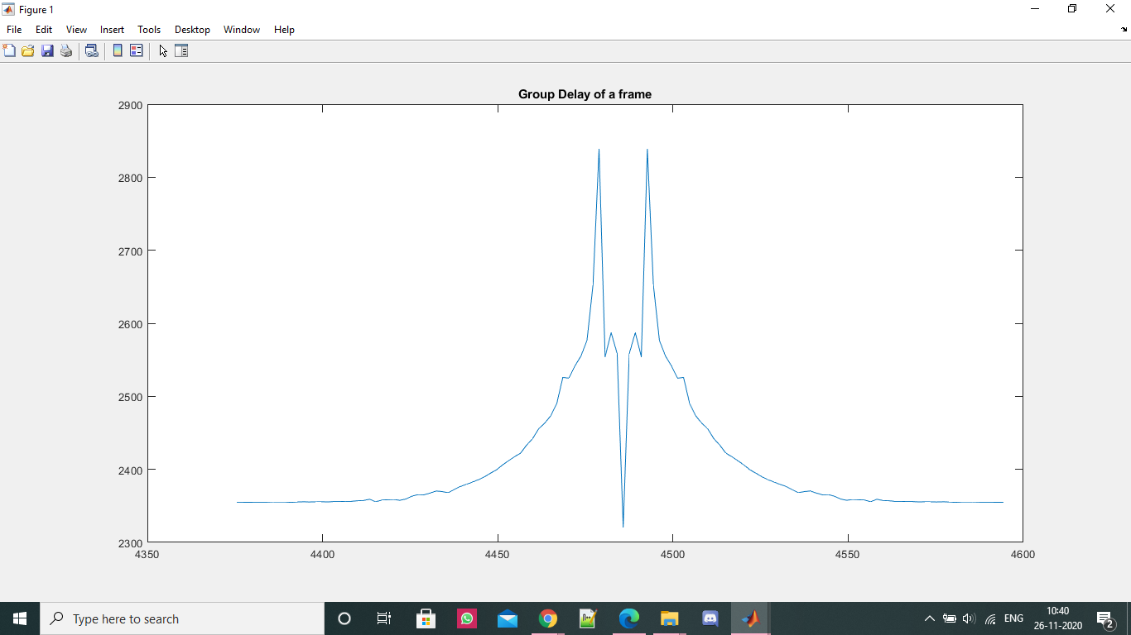
Patient graphs-(1/2)
This graph is group delay function graph for utterance “a” of a patient.
Sampling frequency is 44.1kHz.

Slide 15
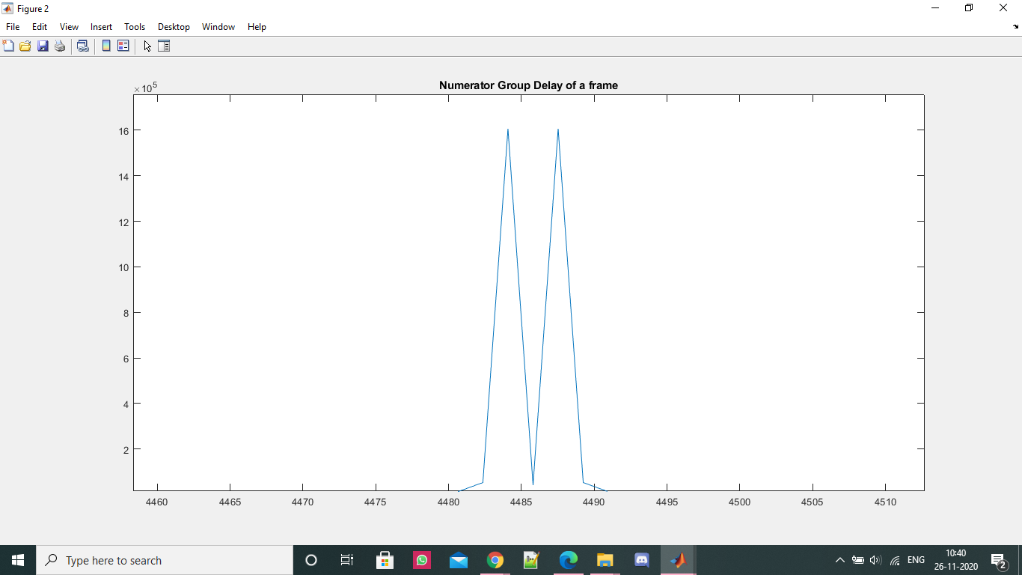
Patient graphs-(2/2)
This graph is numerator group delay function graph for utterance “a” of a patient.
Sampling frequency is 44.1kHz.

Slide 16
Observations:-
The very first thing to note is how numerator group delay/product spectrum is better than group delay. This is because the magnitude term in the denominator of group delay makes it risky because if the magnitude is small then the group delay will seem like an impulse function.
Assumption while all these graphs are plotting is, they are plotted under similar conditions(same number for fft etc.,)
While plotting what we have observed is when you try to plot group delay/numerator group delay the number of points of fft makes a difference.
This is because when fft for higher number size is calculated the values become more resolved/ higher precision because of which values comc close.
Although it is important to have resolution, if we increase the size of fft by more than required, we can see impulse like graphs because the derivative won't be very stable
Another thing to note is formant frequencies(top 15) for patient will be of less dimension than healthy person.

Slide 17
Formant Frequencies
Formant analysis provides information about the frequency spectrum. Each utterance has a clearly defined location of formant which captures the resonant frequency of the vocal tract system
So while analysis of pathological speech, analysing formant frequencies can provide a clear perspective to differentiate between a healthy person and a patient.
The above statement hold because SLI is caused by abnormality in cleft palate, and if cleft palate is abnormal, the the resonant frequencies will also change.
So we have chose to analyse formants for both healthy and patients using numerator group delay process and then classify using those frequencies

Slide 18
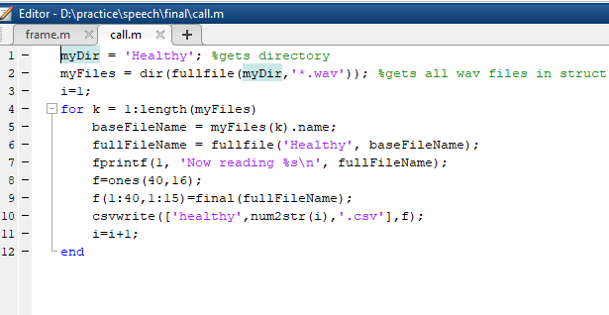
Helper Function-matlab snippet
This the script used to send all the .wav files to the code and then save the matrix as csv file

Slide 19
Pseudo Code-matlab
Take a speech signal and divide it into 25ms.
Create another signal x, which is obtained by multiplying n to the speech signal y to obtain differentiative term.
Apply hamming window on both x,y with overlap step of 5ms.
Calculate fft’s both x,y and substitute according to the given formula.
Divide sampling frequency to same as fft(x) or fft(y) and take the same frame.
Find peaks in the numerator group delay function using findpeaks function.
Sort the peaks and take top 15 peak locations.
Use this location to get the formant frequencies in that particular frame. Calculate for all frames and store in matrix.
Output the matrix.

Slide 20
Machine Learning part
We used SVM(support vector Machine) for machine learning model.
We use cross validation to calculate accuracy and prevent overfitting on the date.
It is a popular method because it is simple to understand and procedure is as follows:
Shuffle the dataset randomly and split it into k groups.(we took k=5)
Take the group as a hold out or test data set
Take the remaining groups as a training data set
Fit the model on the training set and evaluate it on the test set
Retain the evaluation score and discard the model
Calculate mean of scores to get the final accuracy

Slide 21
Pseudo Code-python
Download the above matrix for each .wav file as .csv files and load into the notebook using os library.
Read each csv as a dataframe and seperate the last column which is the id(0-healthy, 1-patient)
Calculate the mean, standard deviation, skewness and kurtosis
Skewness is a measure of asymmetry and kurtosis is a measure how much the tails of this distribution are different from normal distribution
Append them horizontally to get the final feature vector
Create a model(Here SVM)
Use inbuilt libraries for K Fold and cross_validation_score to split the dataset and fit the model. Calculate accuracy using the mean(scores)

Slide 22
Results:-
When we used only vowels for training the model, we got 60 percent accuracy.
When we used the whole dataset(which makes the model more robust), we got around the same values.

Slide 23
THANK YOU

